Slide 1

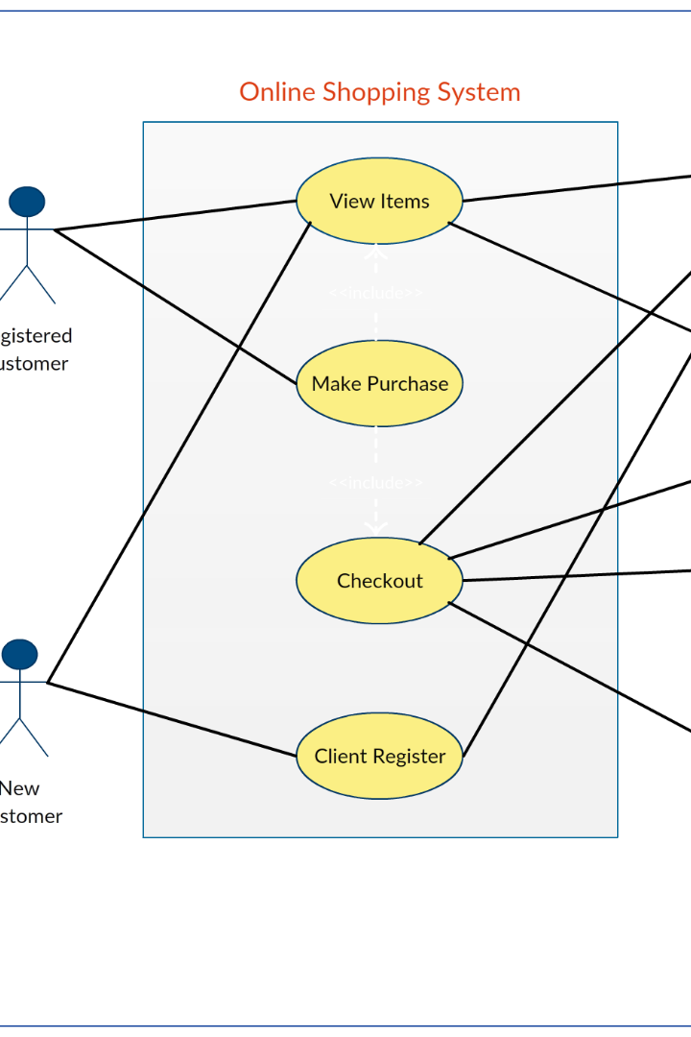

Use Case Diagrams
Use Case Diagrams are an essential part of system analysis and design. Learn about the purpose, components, and benefits of Use Case Diagrams, as well as how to create them effectively.
by Dr. Adeel Ansari

Slide 2
Introduction
1
Purpose of Use Case Diagrams
2
Definition of Use Case Diagrams
Use Case Diagrams help to describe the interaction between users (actors) and a system, capturing the system's functionalities.
A Use Case Diagram is a visual representation that illustrates the relationships between actors and use cases within a system.
1
Components of Use Case Diagrams
2
Actors
Actors represent different users or external systems interacting with the system.
Use Case Diagrams consist of actors, use cases, and relationships between actors and use cases.
3
Use Cases
4
Relationships between Actors and Use Cases
Use Cases represent specific functionalities or actions the system can perform.
Lines and arrows show the relationships between actors and the use cases they interact with.

Slide 3

Benefits of Use Case Diagrams
1
Visual representation of system functionality
2
Communication tool for stakeholders
Use Case Diagrams provide a clear visualization of the features and interactions within a system.
Use Case Diagrams help stakeholders understand and communicate the requirements of a system effectively.

Slide 4
How to Create Use Case Diagrams
1
Identify actors and their roles
Determine the different actors involved in the system and their respective roles.
Identify use cases and their interactions
2
Identify the main functionalities of the system and how actors interact with them.
3
Define relationships between actors and use cases
Establish connections and interactions between actors and the use cases they are associated with.

Slide 5

Best Practices for Use Case Diagrams
1
Keep diagrams simple and easy to understand
2
Regularly update and refine diagrams based on changes in the system
Avoid clutter and complexity in Use Case Diagrams to ensure clarity for all stakeholders.
Keep Use Case Diagrams up-to-date to accurately reflect the current state of the system.

Slide 6
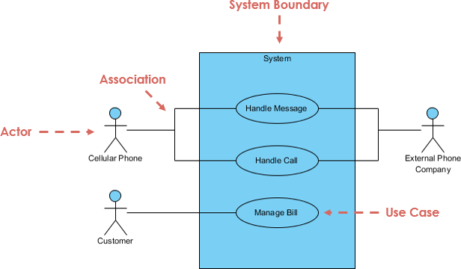

Slide 7
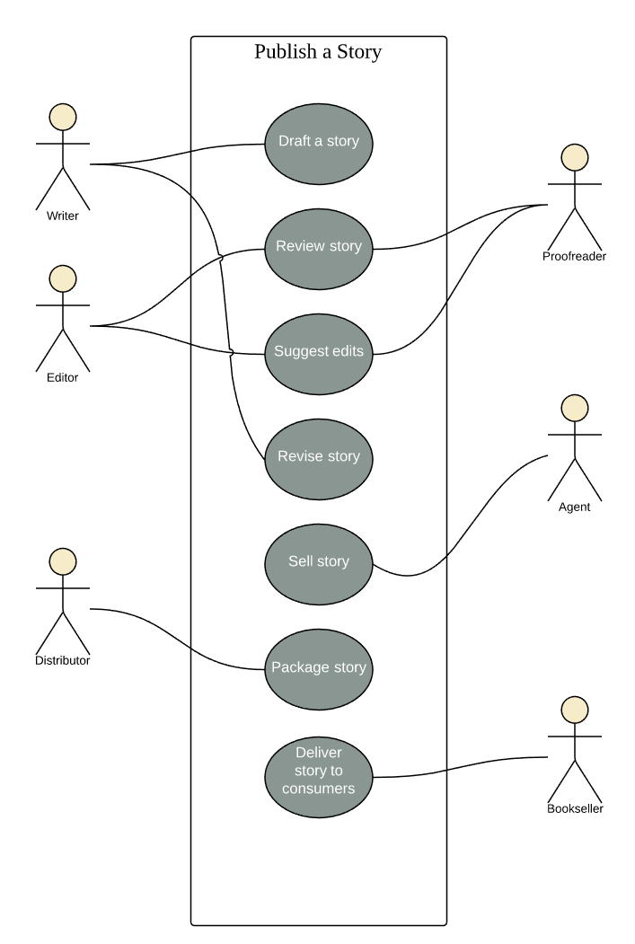

Slide 8
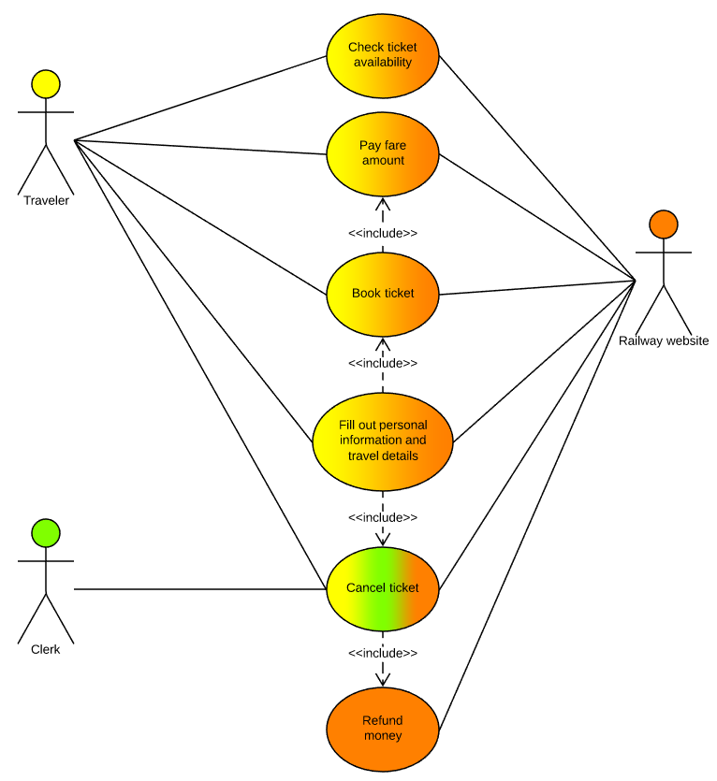

Slide 9
Generalization
A generalization relationship is a parent-child relationship between use cases.
The child use case is an enhancement of the parent use case.
Generalization is shown as a directed arrow with a triangle arrowhead.
The child use case is connected at the base of the arrow. The tip of the arrow is connected to the parent use case.

Slide 10
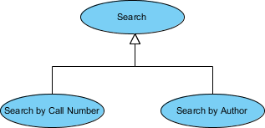
Generalization
A generalization relationship means that a child use case inherits the behavior and meaning of the parent use case.
The child may add or override the behavior of the parent. The figure below provides a use case example by showing two generalization connectors that connect between the three use cases.

Slide 11
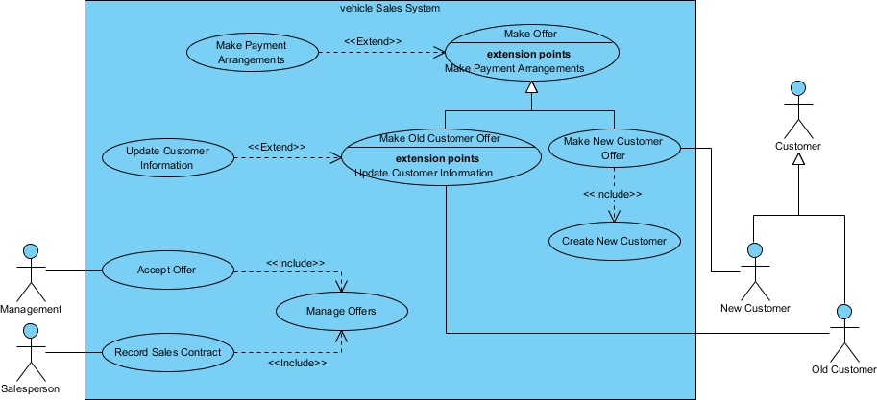
Use Case Diagram - Vehicle Sales Systems

Slide 12
Conclusion
Use Case Diagrams are a powerful tool for system analysis and design, providing a visual representation of system functionality and facilitating effective communication with stakeholders.

